Slide 1
Data Literacy
Jan. 25, 2021
CSC-201
Oral Roberts University

Slide 2
Data is not insight; oil is not gas.
Raw Material
Process
Product
Data Science
Data
Insight
Crude Oil
Refinement
Gas

Slide 3
What is the value of insight?
“Without [analyzed (personal inference) ] data, you’re just another person with an opinion.” - W. Edwards Deming

Slide 4
Class Objectives
Build a working conceptual knowledge about data
Gain a comprehension of data in its different forms and contexts
Practice reading a real-world data set

Slide 5
What does data look like?
Structured
Flat/tabular
Rows and columns…
Focus of this course
Unstructured
Not flat/tabular
Majority of all data falls into this category
Difficult to analyze (e.g. social media censoring)
Examples include documents, emails, audio files, webpages, short-answer response, medical records

Slide 6
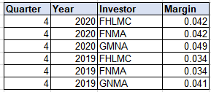
Example: Converting Unstructured to Structured
Email dated 1/19/2021:
“Hi Jen,
Hope you are well! I wanted to let you know that our origination margins for last quarter were at 4.2% for conventional investors, 24% higher than a year earlier. GNMA margins were 4.9%, +19% difference from the previous year. Crazy to see rates through the floor like this – would’ve never guessed!
Thanks, Cathy”

Slide 7

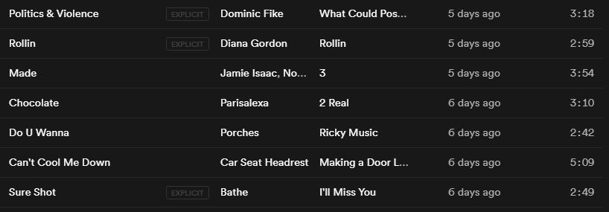
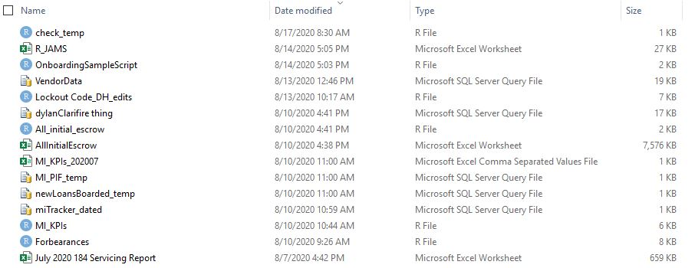
Common Examples of Structured Data

Slide 8
Characteristics of Structured (i.e., tabular) Data
Questions to ask of your data
Consists of rows and columns
Each row has the same columns as the other rows, in the same order.
A given column consists of the same homogeneous data type, but different columns can have different data types.
No multi-value cells
What is this data about?
What does one row represent?
What is the source?
How was it collected?
When was it collected, and is it being updated?
What kind of information do we have about each row?
To what extent are there missing/null/NA values?

Slide 9
Data Types (a.k.a. variable types)
Continuous
Numerical
Can perform mathematic functions
Theoretically infinite number of possible values between any two points
Discrete
Categorical
Sub-types
Character (categories, identifiers)
Boolean (true/false)
Factor (ordered categories)
Dates? Time? Money?

Slide 10

Practice Example
“mtcars” data set description

Slide 11
Terminology
Columns = Variables, Features, Factors, Fields
Rows = Observations, Records, Lines
Header = Column Names
Row Names = An index column that comes first in the data set. Usually just in the form of row numbers, but with mtcars, the row names are the actual Make/Model

